Slide 1
IBM DS Capstone Project

Slide 2
Description of the problem and a discussion of the background
Buenos Aires is the capital and the largest city of Argentina. Located on the western shore of Río de la Plata, is also known as the fourth metropolitan area in Latin America, with a population of around 16 million including greater Buenos Aires (source: Wikipedia). The city of Buenos Aires itself is an autonomous district. It is known for its European architecture, multicultural life and home of multiple ethnic and religious groups given by it's strong history of inmigration, both nationally (from interior to Buenos Aires) and internationally (mainly from Europe during 19th and 20th century, but also from bordering countries during last decades of 20th century). According to the 2010th census, the city of Buenos Aires had approximately 3 million people. The population of Greater Buenos Aires was more than 13 million.
More than 60% of the city's residents live in apartment buildings and 30% in single-family homes. Measured in terms of income, the city's has a low poverty rate compared to Greater BA and other provinces.
However and due to macroeconomic problems of last 20 to 30 years a lot of urban problems started to raise. Mainly urban growth, accesable housing, problems with the quality of public services, security, crimes, education, among others. Also there has benn a significant increase of "villas" that started to spread out across the city around 1980/1990's.
On the other hand, due to the implosion of financial sector during last 20 years crisis, mortgage loans have been rapidily decreasing, therefore, a lot of families and new generations of citizens, have started to live in rented houses or apartments, rather than buying one with bank debt, unlike older generations of citizens.
Purpose of this project: locate the best neighborhood in the City of Buenos Aires, to rent an apartment.

Slide 3
Description of the data and how it will be used to solve the problem
In order to perform the analysis for the project, some information has to be retrieved and analyze.
  1. Foursquare API Data: foursquare location information regarding data about different venues in different neighborhoods.
  2. List of Buenos Aires neighborhoods.

Slide 4
Description of libraries and how they will be used
1. Pandas: create and manipulate data frames.
2. Folium: visualization library to visualize the neighborhood cluster distribution using maps.
3. Scikit Learn: k-means clustering.
4. JSON: handle JSON files.
5. Geocoder: retrieve Location Data.

Slide 5
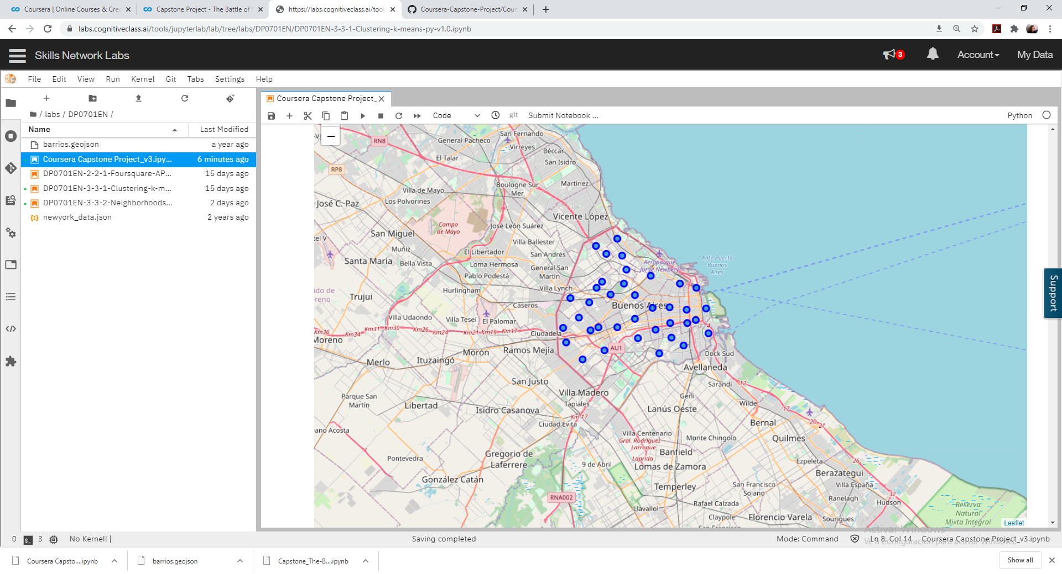
Map of all Buenos Aires neighborhoods

Slide 6
Table with the number of venues of each Buenos Aires neighborhoods

Slide 7
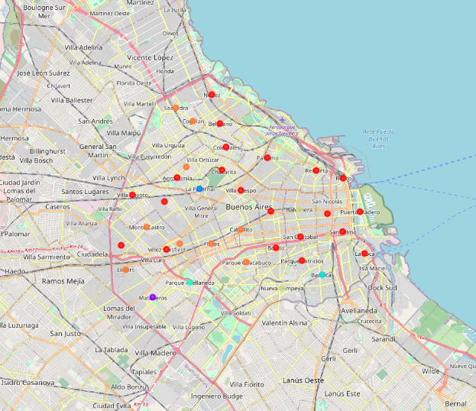
Map with all the clusters of Buenos Aires

Slide 8
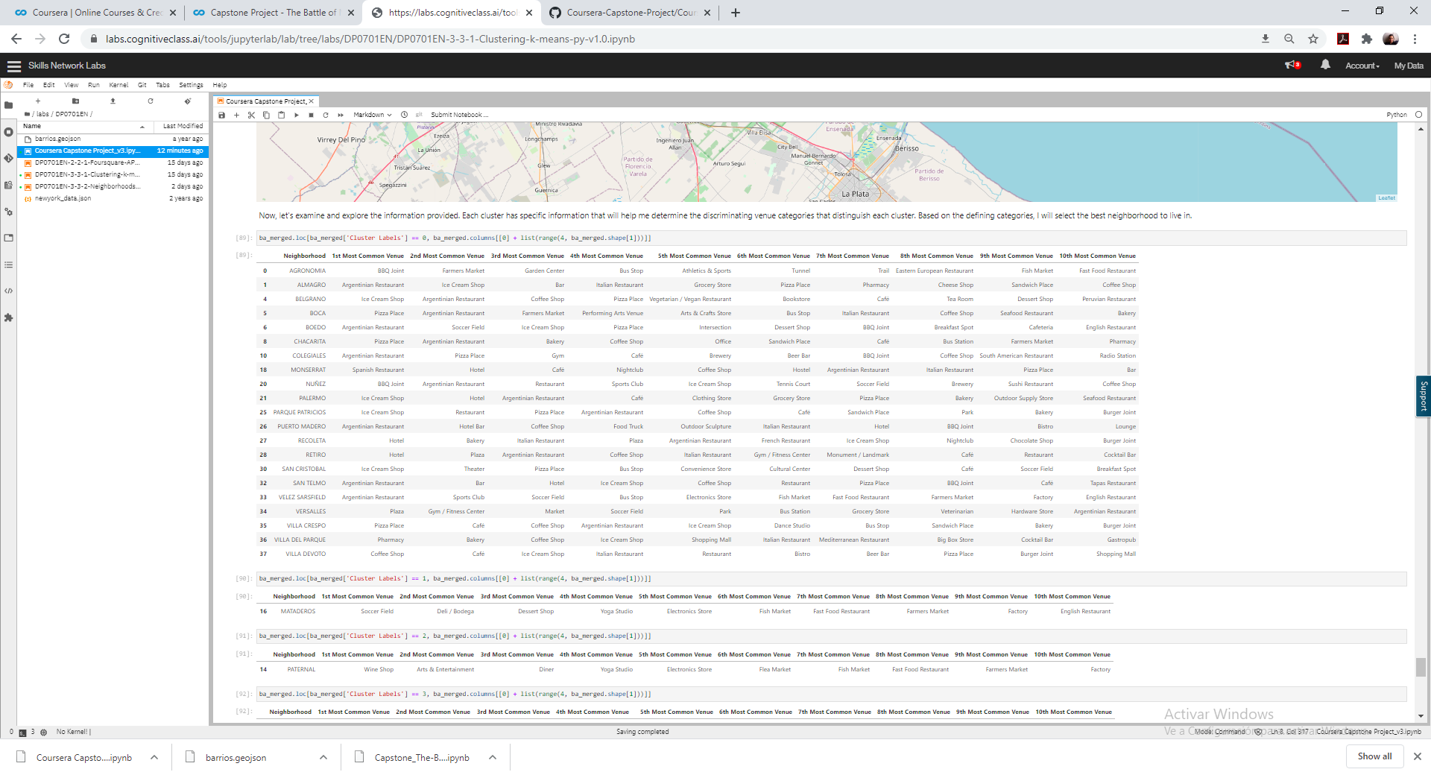
Results with all clusters

Slide 9
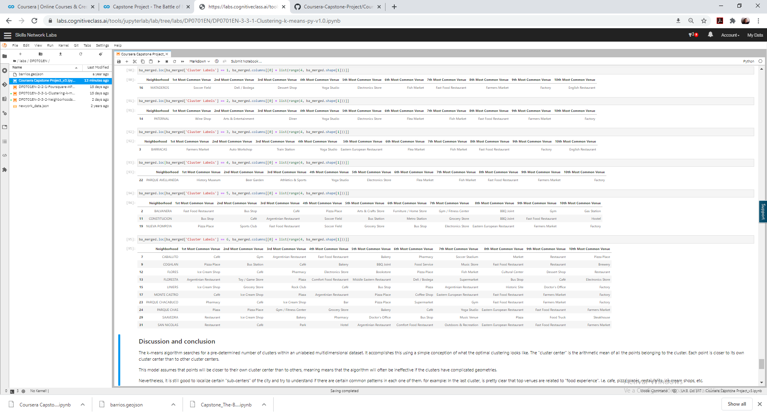
Results with all clusters

Slide 10
Results with all clusters

Slide 11
Discussion and Conclusion
The k-means algorithm searches for a pre-determined number of clusters within an unlabeled multidimensional dataset. It accomplishes this using a simple conception of what the optimal clustering looks like. The "cluster center" is the arithmetic mean of all the points belonging to the cluster.
Each point is closer to its own cluster center than to other cluster centers.
This model assumes that points will be closer to their own cluster center than to others, meaning means that the algorithm will often be ineffective if the clusters have complicated geometries.
Nevertheless, it is still good to localize certain "sub-centers" of the city and try to understand if there are certain common patterns in each one of them. for example: In the last cluster, is pretty clear that top venues are related to "food experience". I.e. cafe, pizza places, restaurants, ice cream shops, etc.
Therefore, I will use this information to determine the best place to rent my apartment.

